Slide 1
-Group 3 Project 2- US WILDFIRE DATABASE
Kaylon Young, Behrouz Zand, Tobias Judd, Rob Pascarella

Slide 2

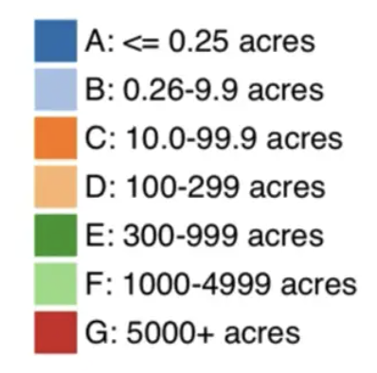

Project Abstract
As stated in the proposal, the initial dataset was found to have 1.88 million geo-referenced wildfire records: almost 1GB of total data. This obviously created synchronous issues with GitHub. Even if this amount of data was usable, the end user would experience performance issue.
To make the project more manageable, the data was filtered to only study “Class G” fires.
These Class G fires were then cleaned for missing fields, dropped rows that were not critical for analysis.
Wildfires Class Size

Slide 3






-The Guts- Tools Utilized for Project Success
Navigation bar and other user-friendly HTML aspects
Interactive, informative page
Bootstrap containers for visual appeal
Flask App communicates with PostgreSQL
D3 utilized to pull jsonified data
Leaflet map featuring coolest-ever selection slider
Chart.js build/destroy method over every iteration creates clean maps
State Choropleth plot
Selection of state updates new latitude/longitude, centered in plot.ly map
Chart.js Scatterplot

Slide 4
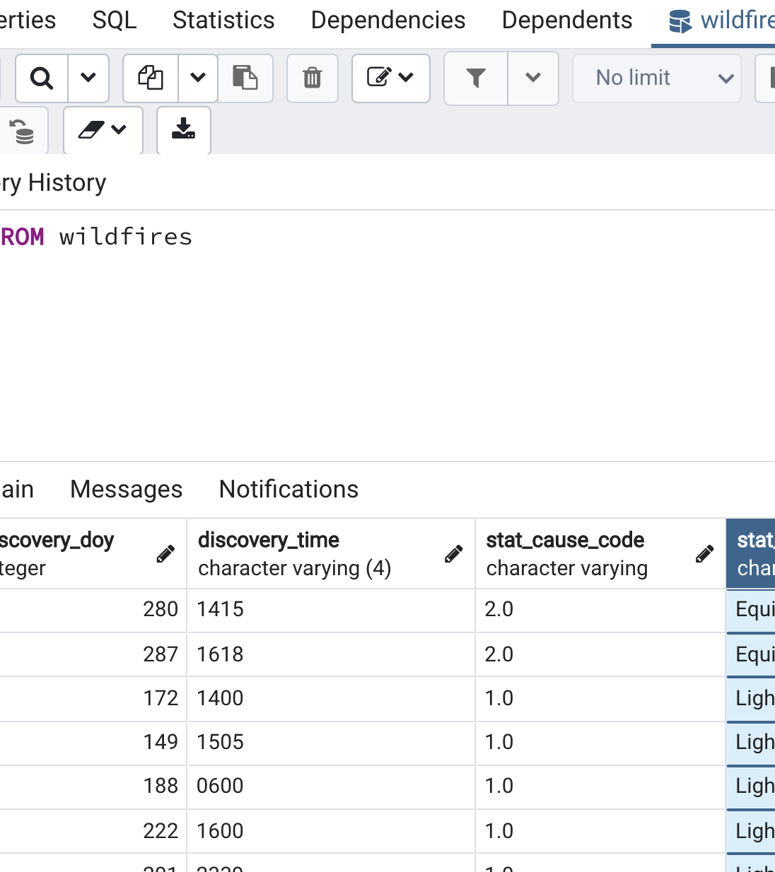

SQL Data
Local Server was utilized
.sqlite was imported to jupyter notebook
SQLAlchemy with Postgres database
Formulated dashboard by exportation of the resulting clean via .csv file

Slide 5
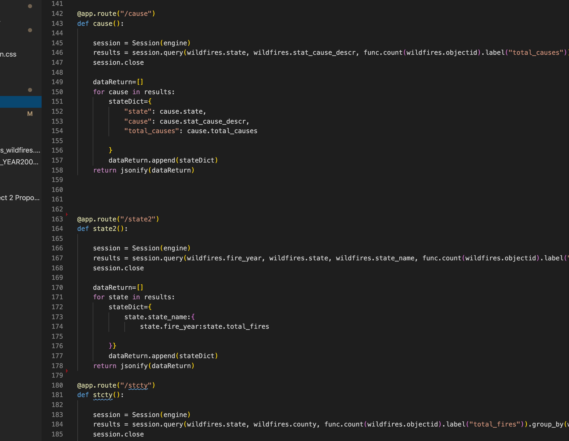

Flask Application
Data crunching ENGINE

Slide 6

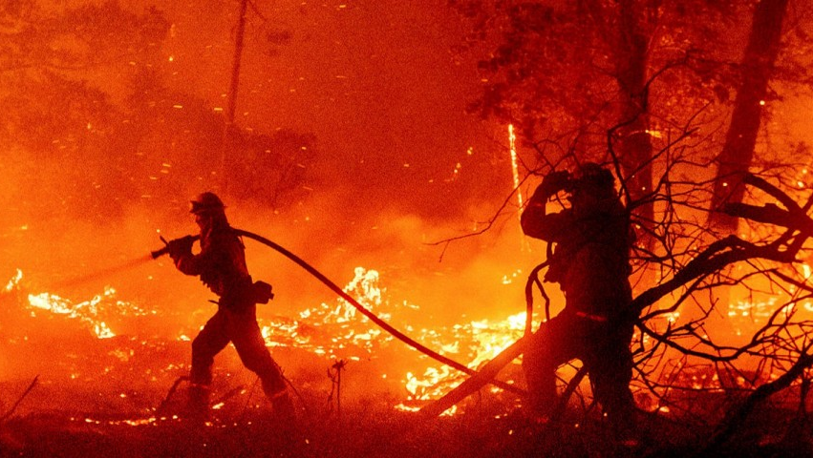
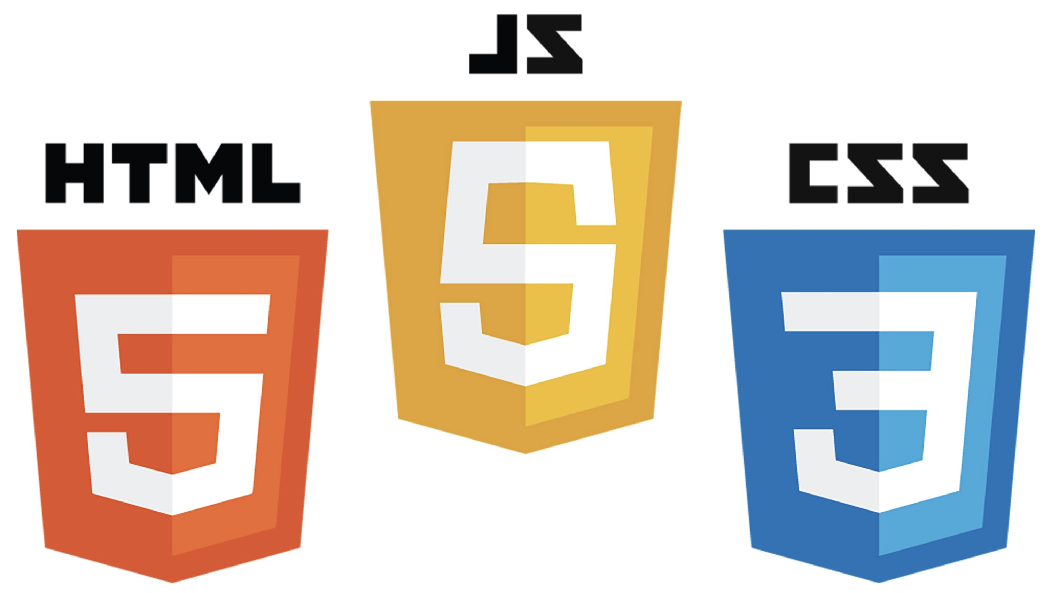



Front END
Utilization of video looping drives engagement

Slide 7
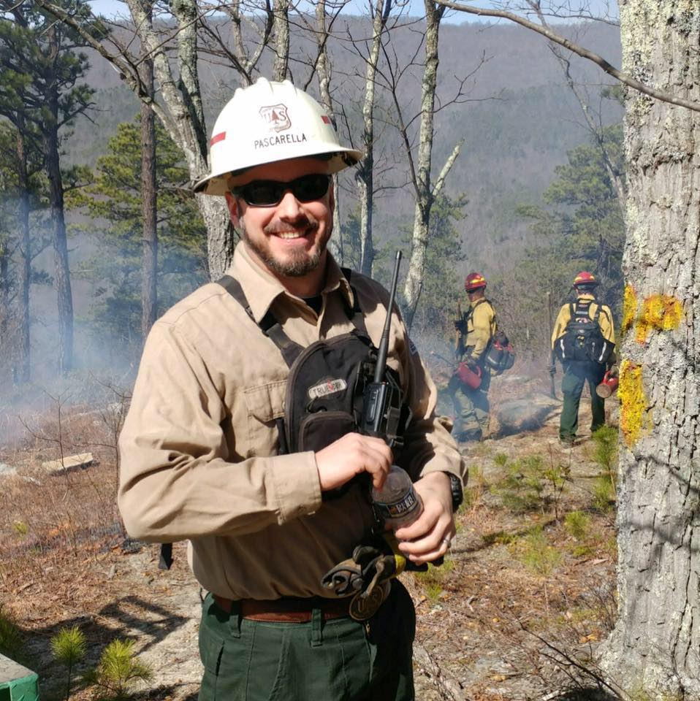
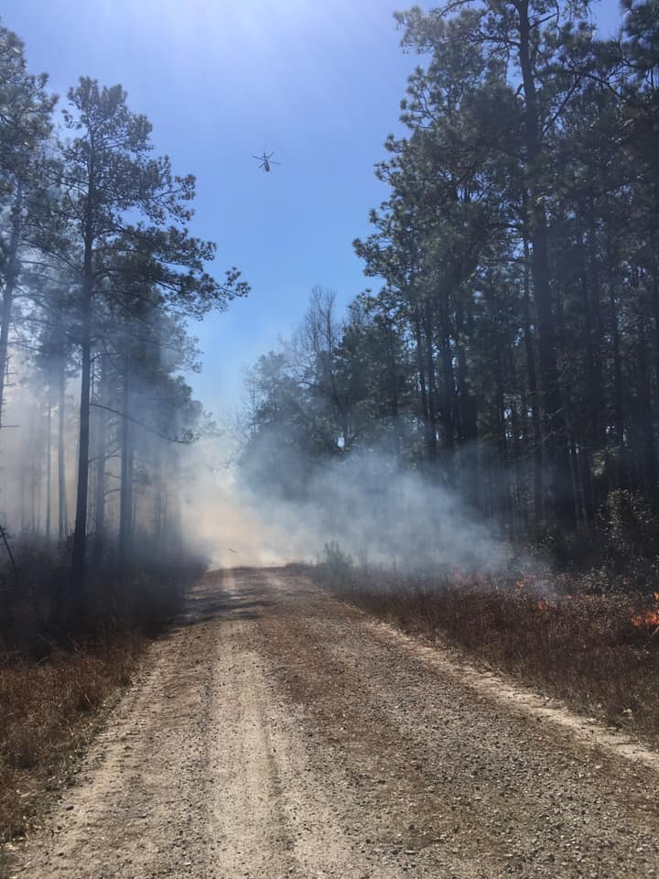
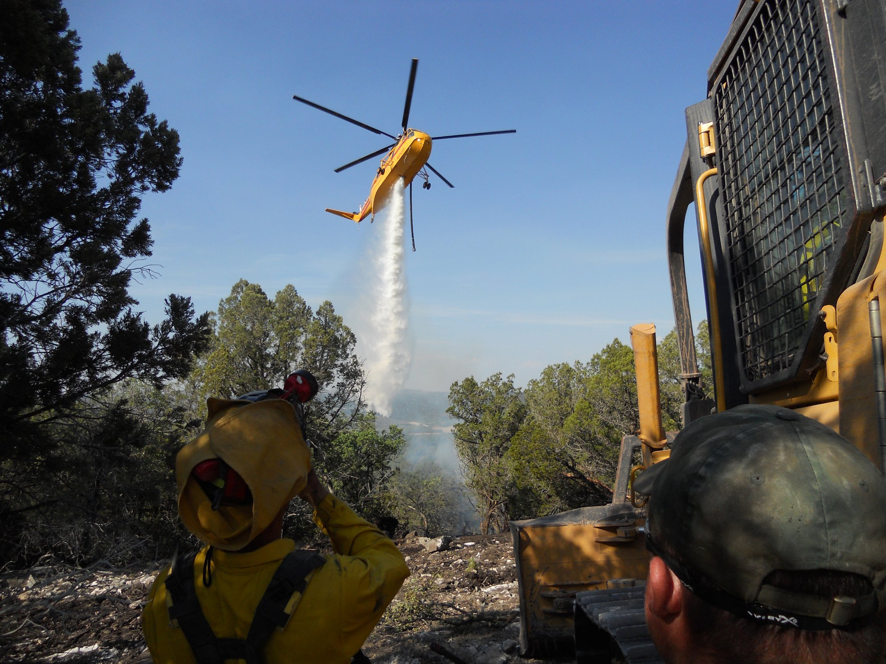


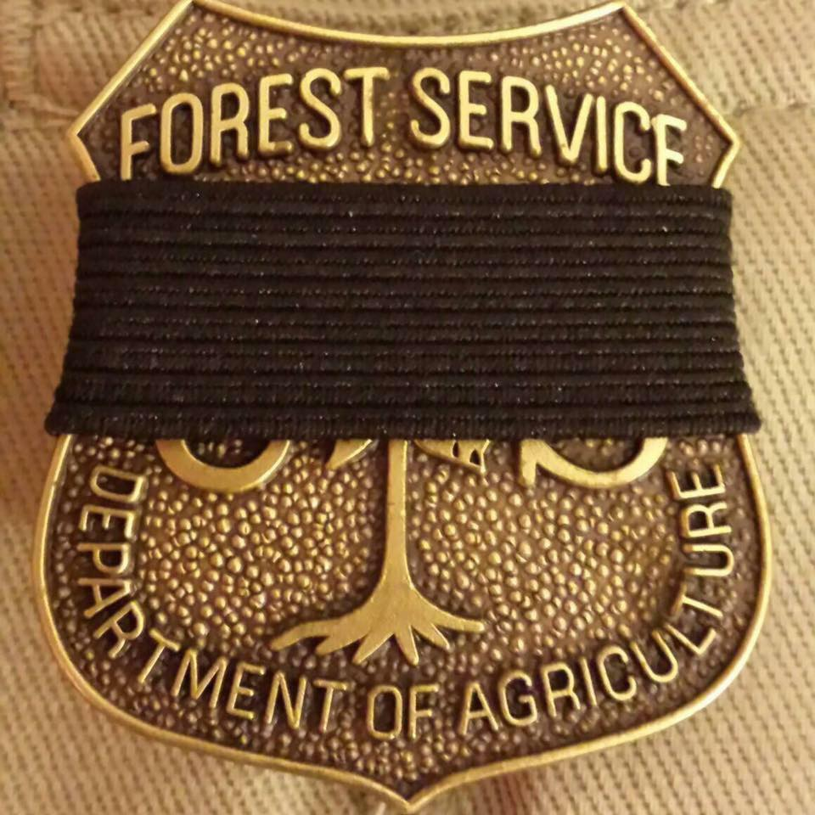
THANK YOU

